Slide 1
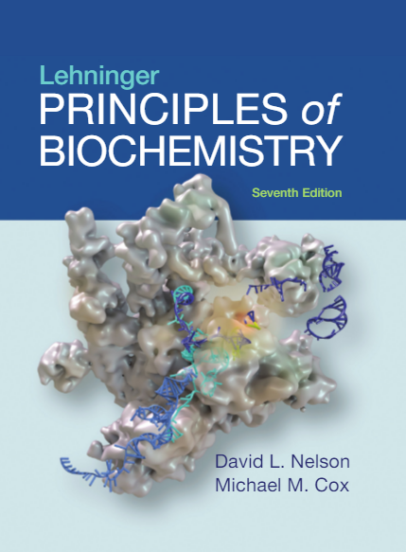
16| The Citric Acid Cycle
© 2017 W. H. Freeman and Company

Slide 2
CHAPTER 16: The Citric Acid Cycle
Learning goals:
Cellular respiration
Conversion of pyruvate to activated acetate
Reactions of the citric acid cycle
Regulation of the citric acid cycle
Amphibolic nature of citric acid cycle intermediates
Mechanisms of replenishing citric acid cycle intermediates

Slide 3
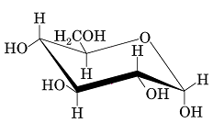
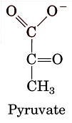
Only a Small Amount of Energy Available in Glucose Is Captured in Glycolysis
Glycolysis
2
ΔG′° = –146 kJ/mol
GLUCOSE
Full oxidation (+ 6 O₂)
6 CO₂ + 6 H₂O
ΔG′° = –2,840 kJ/mol

Slide 4
Cellular Respiration
Process in which cells consume O₂ and produce CO₂
Provides more energy (ATP) from glucose than glycolysis
Also captures energy stored in lipids and amino acids
Evolutionary origin: developed about 2.5 billion years ago
Used by animals, plants, and many microorganisms
Occurs in three major stages:
acetyl CoA production
acetyl CoA oxidation
electron transfer and oxidative phosphorylation

Slide 5
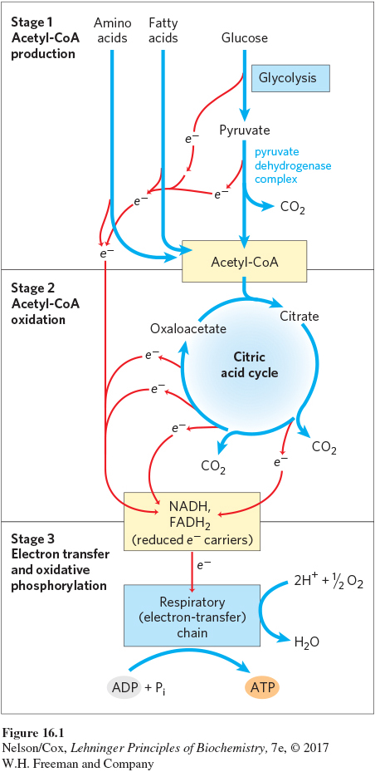
Respiration: Stage 1 Acetyl-CoA Production
Generates some ATP, NADH, FADH₂
Carbohydrates release 1/3 of total potential CO₂ during Stage 1.
Notes:
FIGURE 16–1 (part 1) Catabolism of proteins, fats, and carbohydrates in the three stages of cellular respiration. Stage 1: oxidation of fatty acids, glucose, and some amino acids yields acetyl-CoA.

Slide 6

Respiration: Stage 2 Acetyl-CoA Oxidation
Generates more NADH, FADH₂, and one GTP
Remaining carbon atoms from carbohydrates, amino acids, and fatty acids are released during Stage 2.
Notes:
FIGURE 16–1 (part 2) Catabolism of proteins, fats, and carbohydrates in the three stages of cellular respiration. Stage 2: oxidation
of acetyl groups in the citric acid cycle includes four steps in which electrons are abstracted.

Slide 7
Respiration: Stage 3 Oxidative Phosphorylation
Generates the vast majority of ATP during catabolism
Notes:
FIGURE 16–1 (part 3) Catabolism of proteins, fats, and carbohydrates in the three stages of cellular respiration. Stage 3: electrons carried by NADH and FADH₂ are funneled into a chain of mitochondrial (or, in bacteria, plasma membrane–bound) electron carriers—the respiratory chain—ultimately reducing O₂ to H₂O. This electron flow drives the production of ATP.

Slide 8
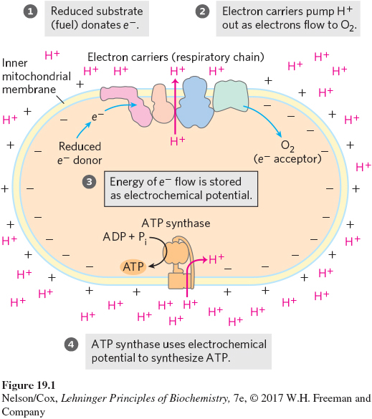
In Eukaryotes, Stages 2 and 3 Are Localized to the Mitochondria
Glycolysis occurs in the cytoplasm.
Citric acid cycle occurs in the mitochondrial matrix†.
Oxidative phosphorylation occurs in the inner membrane.
†Except succinate dehydrogenase, which is located in the inner membrane
Notes:
FIGURE 19–1 The chemiosmotic mechanism for ATP synthesis. (a) In mitochondria, electrons move through a chain of membrane-bound carriers (the respiratory chain) spontaneously, driven by the high reduction potential of oxygen and the relatively low reduction potentials of the various reduced substrates (fuels) that undergo oxidation in the mitochondrion. (b) In chloroplasts, the movement of electrons through a chain of membrane-bound carriers is driven by the energy of photons absorbed by the green pigment chlorophyll. In both organelles, electron flow creates an electrochemical potential by the transmembrane movement of protons and positive charge. In both cases this electrochemical potential drives ATP synthesis by a membrane-bound enzyme, ATP synthase, that is fundamentally similar in both mitochondria and chloroplasts, and in bacteria and archaea as well.

Slide 9
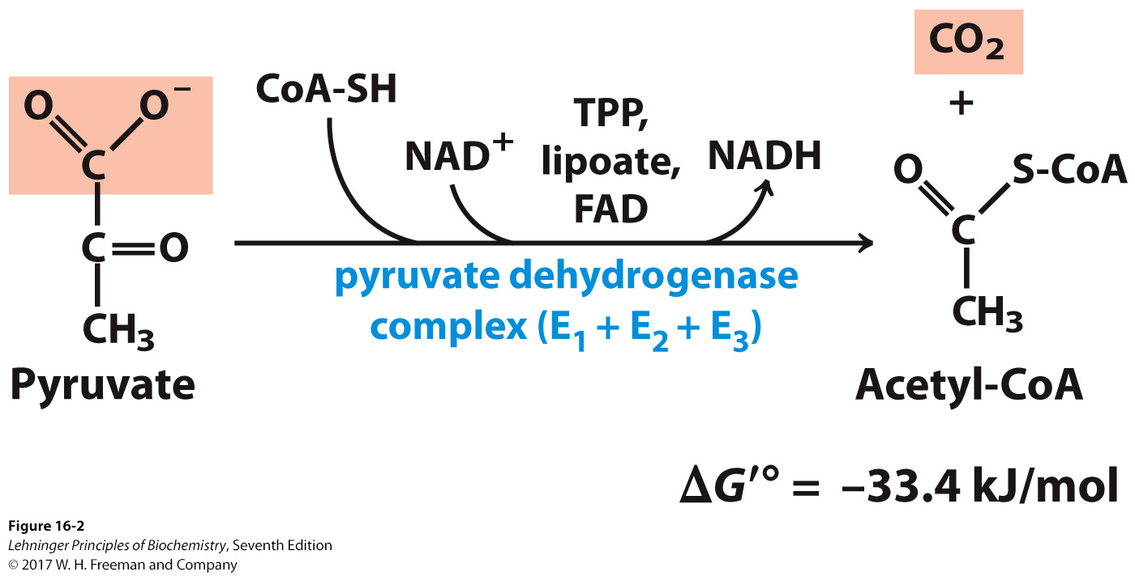
Conversion of Pyruvate to Acetyl-CoA
Net reaction:
oxidative decarboxylation of pyruvate
first carbons of glucose to be fully oxidized
Catalyzed by the pyruvate dehydrogenase complex
requires 5 cofactors
TPP, lipoyllysine, and FAD are prosthetic groups.
NAD⁺ and CoA-SH are co-substrates.
Notes:
FIGURE 16–2 Overall reaction catalyzed by the pyruvate dehydrogenase complex. The five coenzymes participating in this reaction, and the three enzymes that make up the enzyme complex, are discussed in the text.

Slide 10
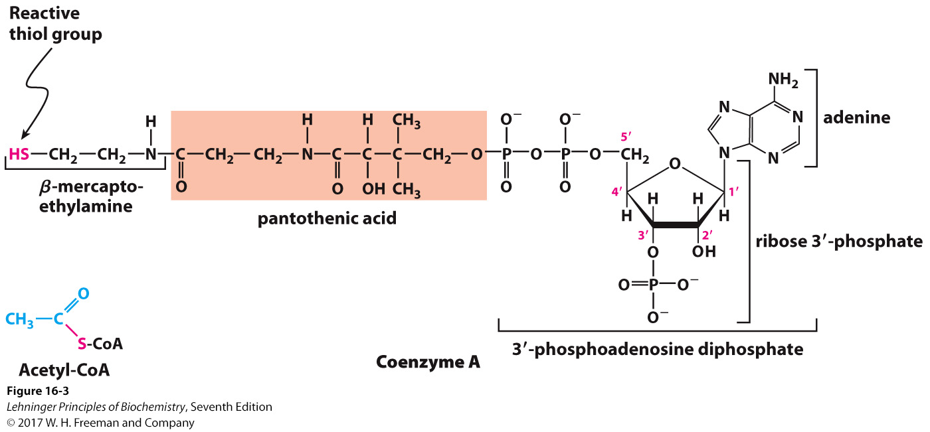
Structure of Coenzyme A
The function of CoA is to accept and carry acetyl groups.
Notes:
FIGURE 16–3 Coenzyme A (CoA). A hydroxyl group of pantothenic acid is joined to a modified ADP moiety by a phosphate ester bond, and its carboxyl group is attached to β-mercaptoethylamine in amide linkage. The hydroxyl group at the 3’ position of the ADP moiety has a phosphoryl group not present in free ADP. The —SH group of the mercaptoethylamine moiety forms a thioester with acetate in acetyl-coenzyme A (acetyl-CoA) (lower left).

Slide 11
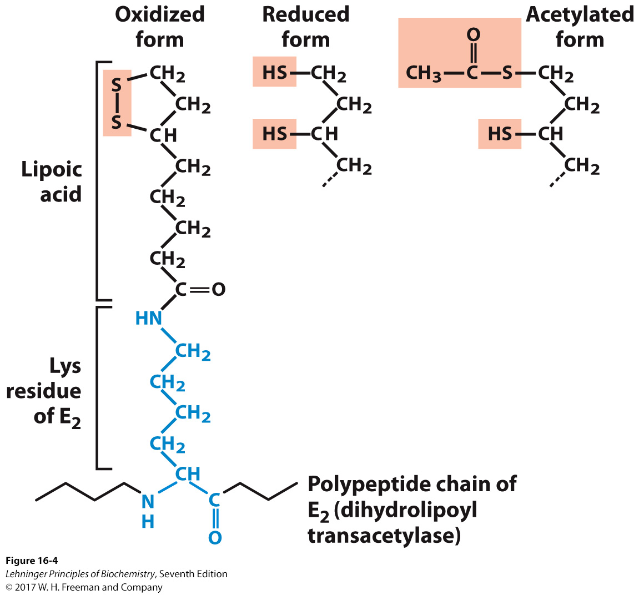
Structure of Lipoyllysine
Prosthetic groups are strongly bound to the protein.
The lipoic acid is covalently linked to the enzyme via a lysine residue
Acts as a carrier of both hydrogen and an acetyl group.
Notes:
FIGURE 16–4 Lipoic acid (lipoate) in amide linkage with a Lys residue. The lipoyllysyl moiety is the prosthetic group of dihydrolipoyl transacetylase (E₂ of the PDH complex). The lipoyl group occurs in oxidized (disulfide) and reduced (dithiol) forms and acts as a carrier of both hydrogen and an acetyl (or other acyl) group.

Slide 12
Pyruvate Dehydrogenase Complex (PDC)
PDC is a large (up to 10 MDa) multienzyme complex.
pyruvate dehydrogenase (E₁)
dihydrolipoyl transacetylase (E₂)
dihydrolipoyl dehydrogenase (E₃)
Advantages of multienzyme complexes:
The short distance between catalytic sites allows channeling of substrates from one catalytic site to another.
Channeling minimizes side reactions.
The regulation of activity of one subunit affects the entire complex.

Slide 13
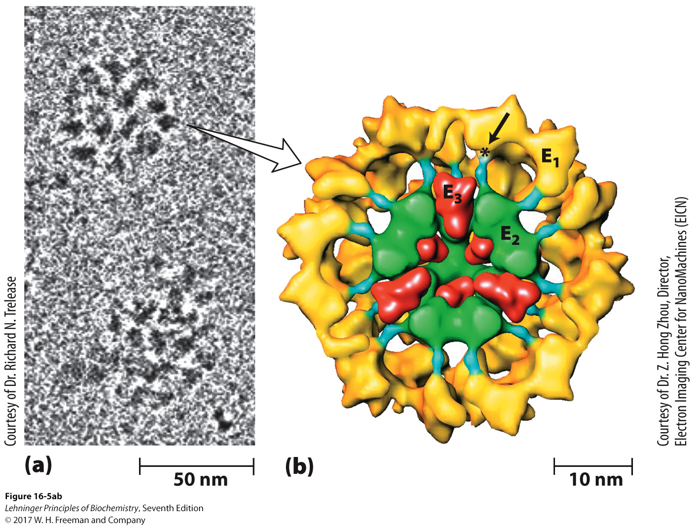
Cryoelectronmicroscopy of PDC
Samples are in a near-native frozen hydrated state.
Low temperature protects biological specimens against radiation damage.
Electrons have a smaller de Broglie wavelength and produce much higher-resolution images than light.
The lipoyl domain of E₂ (blue) reaches outward to touch the active sites of E₁ molecules (yellow) arranged on the E₂ core.
Notes:
FIGURE 16–5a,b The pyruvate dehydrogenase complex. (a) Cryoelectron micrograph of PDH complexes isolated from bovine kidney. In cryoelectron microscopy, biological samples are viewed at extremely low temperatures; this avoids potential artifacts introduced by the usual process of dehydrating, fixing, and staining (see Box 19-1). (b) Threedimensional image of PDH complex, showing the subunit structure: E₁, pyruvate dehydrogenase; E₂, dihydrolipoyl transacetylase; and E₃, dihydrolipoyl dehydrogenase. This image is reconstructed by analysis of a large number of images such as those in (a), combined with crystallographic studies of individual subunits. The core (green) consists of 60 molecules of E₂, arranged in 20 trimers to form a pentagonal dodecahedron. The lipoyl domain of E₂ (blue) reaches outward to touch the active sites of E₁ molecules (yellow) arranged on the E₂ core. Several E₃ subunits (red) are also bound to the core, where the swinging arm on E₂ can reach their active sites. An asterisk marks the site where a lipoyl group is attached to the lipoyl domain of E₂. To make the structure

Slide 14
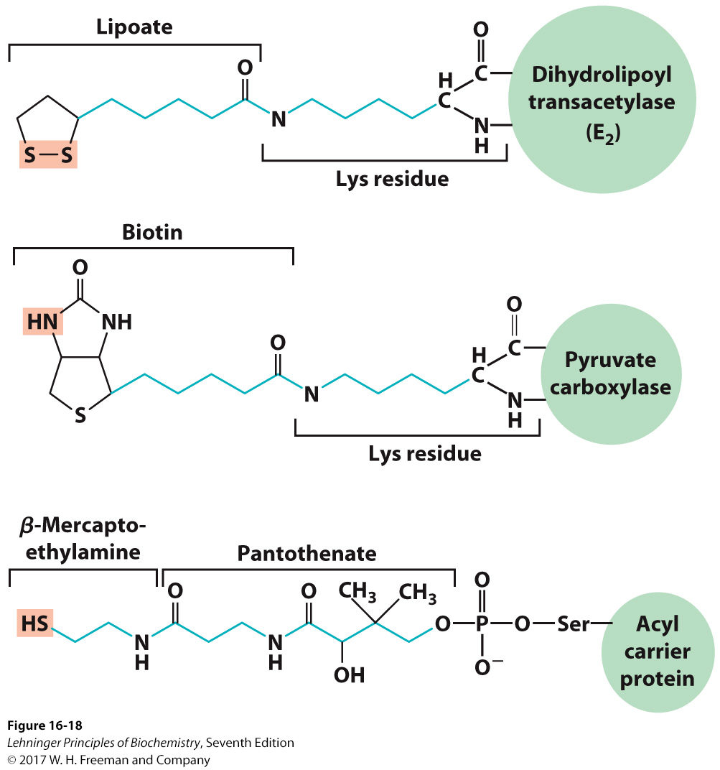
Biological Tethers Allow Flexibility
Notes:
FIGURE 16–18 Biological tethers. The cofactors lipoate, biotin, and the combination of β-mercaptoethylamine and pantothenate form long, flexible arms (blue) on the enzymes to which they are covalently bound, acting as tethers that move intermediates from one active site to the next. The group shaded light red is in each case the point of attachment of the activated intermediate to the tether.

Slide 15
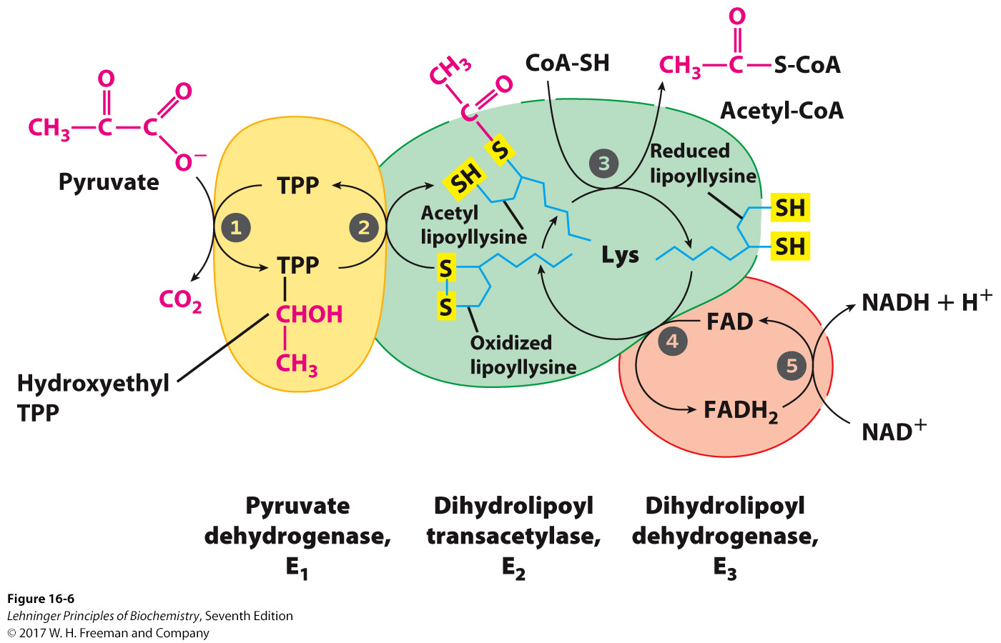
Overall Reaction of PDC
Dehydrogenase: oxidizes a substrate by reducing an electron acceptor
The long lipoyllysyl arm swings from the active site of E₁ to E₂ to E₃, tethering the intermediates to the enzyme complex to allow substrate channeling.
.
Notes:
FIGURE 16–6 Oxidative decarboxylation of pyruvate to acetyl-CoA by the PDH complex. The fate of pyruvate is traced in red. In step 1 pyruvate reacts with the bound thiamine pyrophosphate (TPP) of pyruvate dehydrogenase (E₁), undergoing decarboxylation to the hydroxyethyl derivative (see Fig. 14–15). Pyruvate dehydrogenase also carries out step 2, the transfer of two electrons and the acetyl group from TPP to the oxidized form of the lipoyllysyl group of the core enzyme, dihydrolipoyl transacetylase (E₂), to form the acetyl thioester of the reduced lipoyl group. Step 3 is a transesterification in which the —SH group of CoA replaces the —SH group of E₂ to yield acetyl-CoA and the fully reduced (dithiol) form of the lipoyl group. In step 4 dihydrolipoyl dehydrogenase (E₃) promotes transfer of two hydrogen atoms from the reduced lipoyl groups of E₂ to the FAD prosthetic group of E₃, restoring the oxidized form of the lipoyllysyl group of E₂. In step 5 the reduced FADH₂ of E₃ transfers a hydride ion to NAD⁺, forming NADH. The enzyme complex is now ready for another catalytic cycle. (Subunit colors correspond to those in Fig. 16–5b.)

Slide 16
Sequence of Events in Oxidative Decarboxylation of Pyruvate
Enzyme 1
Step 1: Decarboxylation of pyruvate to an aldehyde
Step 2: Oxidation of aldehyde to a carboxylic acid
Electrons reduce lipoamide and form a thioester.
Enzyme 2
Step 3: Formation of acetyl-CoA (product 1)
Enzyme 3
Step 4: Reoxidation of the lipoamide cofactor
Step 5: Regeneration of the oxidized FAD cofactor
forming NADH (product 2)

Slide 17
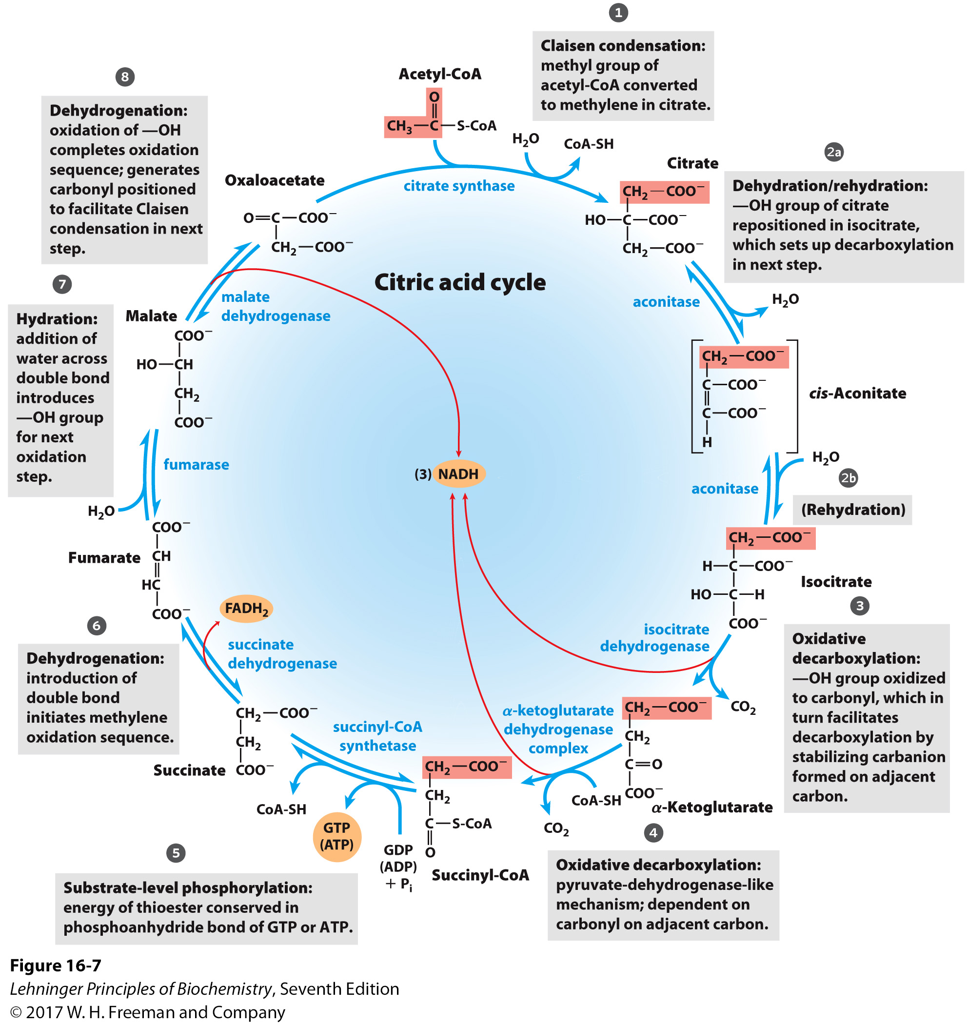
The Citric Acid Cycle (CAC)
Our City Is Kept Safe And Sound From Malice
Citrate Is Kreb’s Starting Substrate For Making Oxaloacetate
Can I Keep Selling Sex For Money, Officer?
Notes:
FIGURE 16–7 Reactions of the citric acid cycle. The carbon atoms shaded in pink are those derived from the acetate of acetyl-CoA in the first turn of the cycle; these are not the carbons released as CO₂ in the first turn. Note that in succinate and fumarate, the two-carbon group derived from acetate can no longer be specifically denoted; because succinate and fumarate are symmetric molecules, C-1 and C-2 are indistinguishable from C-4 and C-3. The number beside each reaction step corresponds to a numbered heading on pages xxx–xxx). The red arrows show where energy is conserved by electron transfer to FAD or NAD⁺, forming FADH₂ or NADH + H⁺. Steps 1, 3, and 4 are essentially irreversible in the cell; all other steps are reversible. The nucleoside triphosphate product of step 5 may be either ATP or GTP, depending on which succinyl-CoA synthetase isozyme is the catalyst.

Slide 18
Sequence of Events in the Citric Acid Cycle
Step 1: C-C bond formation between acetate (2C) and oxaloacetate (4C) to make citrate (6C)
Step 2: Isomerization via dehydration/rehydration
Steps 3–4: Oxidative decarboxylations to give 2 NADH
Step 5: Substrate-level phosphorylation to give GTP
Step 6: Dehydrogenation to give FADH₂
Step 7: Hydration
Step 8: Dehydrogenation to give NADH

Slide 19
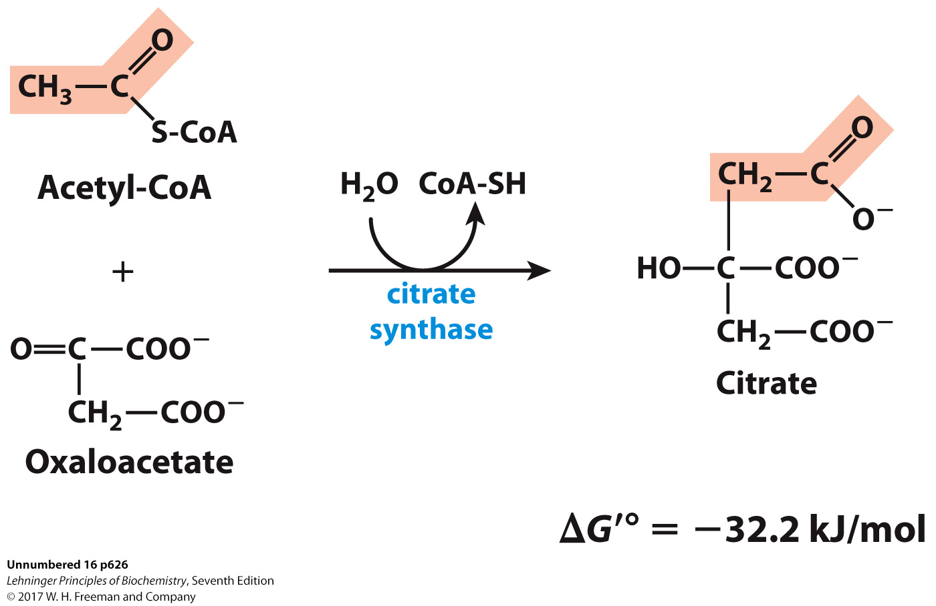
C-C Bond Formation by Condensation of Acetyl-CoA and Oxaloacetate

Slide 20
Citrate Synthase
Condensation of acetyl-CoA and oxaloacetate
The only reaction with C-C bond formation
Uses acid/base catalysis
Carbonyl of oxaloacetate is a good electrophile.
Methyl of acetyl-CoA is not a good nucleophile…
…unless activated by deprotonation.
Rate-limiting step of CAC
Activity largely depends on [oxaloacetate].
Highly thermodynamically favorable/irreversible
regulated by substrate availability and product inhibition

Slide 21
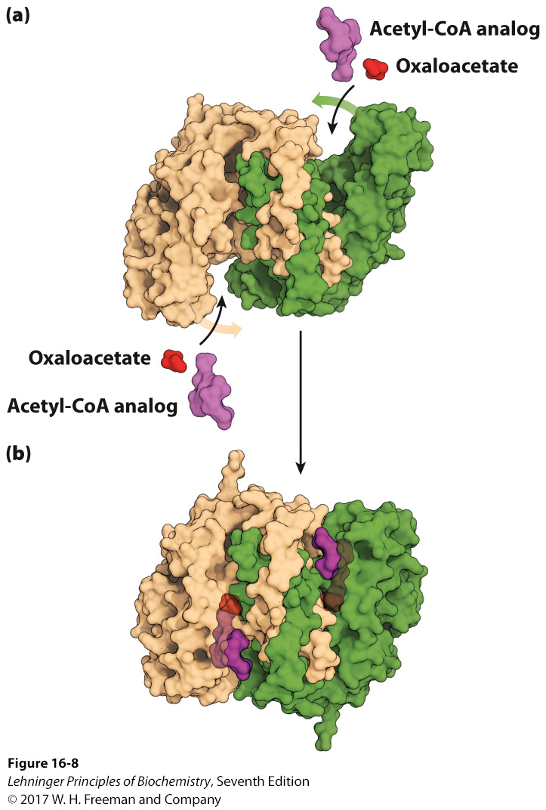
Induced Fit in the Citrate Synthase
Conformational change occurs upon binding oxaloacetate.
Avoids unnecessary hydrolysis of thioester in acetyl-CoA
Open conformation:
Free enzyme does not have a binding site for acetyl-CoA.
Closed conformation:
Binding of OAA creates binding for acetyl-CoA.
Reactive carbanion is protected .
Notes:
FIGURE 16–8 Structure of citrate synthase. The flexible domain of each subunit undergoes a large conformational change on binding oxaloacetate, creating a binding site for acetyl-CoA. (a) Open form of the enzyme alone (PDB ID 5CSC); (b) closed form with bound oxaloacetate and a stable analog of acetyl-CoA (carboxymethyl-CoA) (derived from PDB ID 5CTS). In these representations one subunit is colored tan and one green.

Slide 22
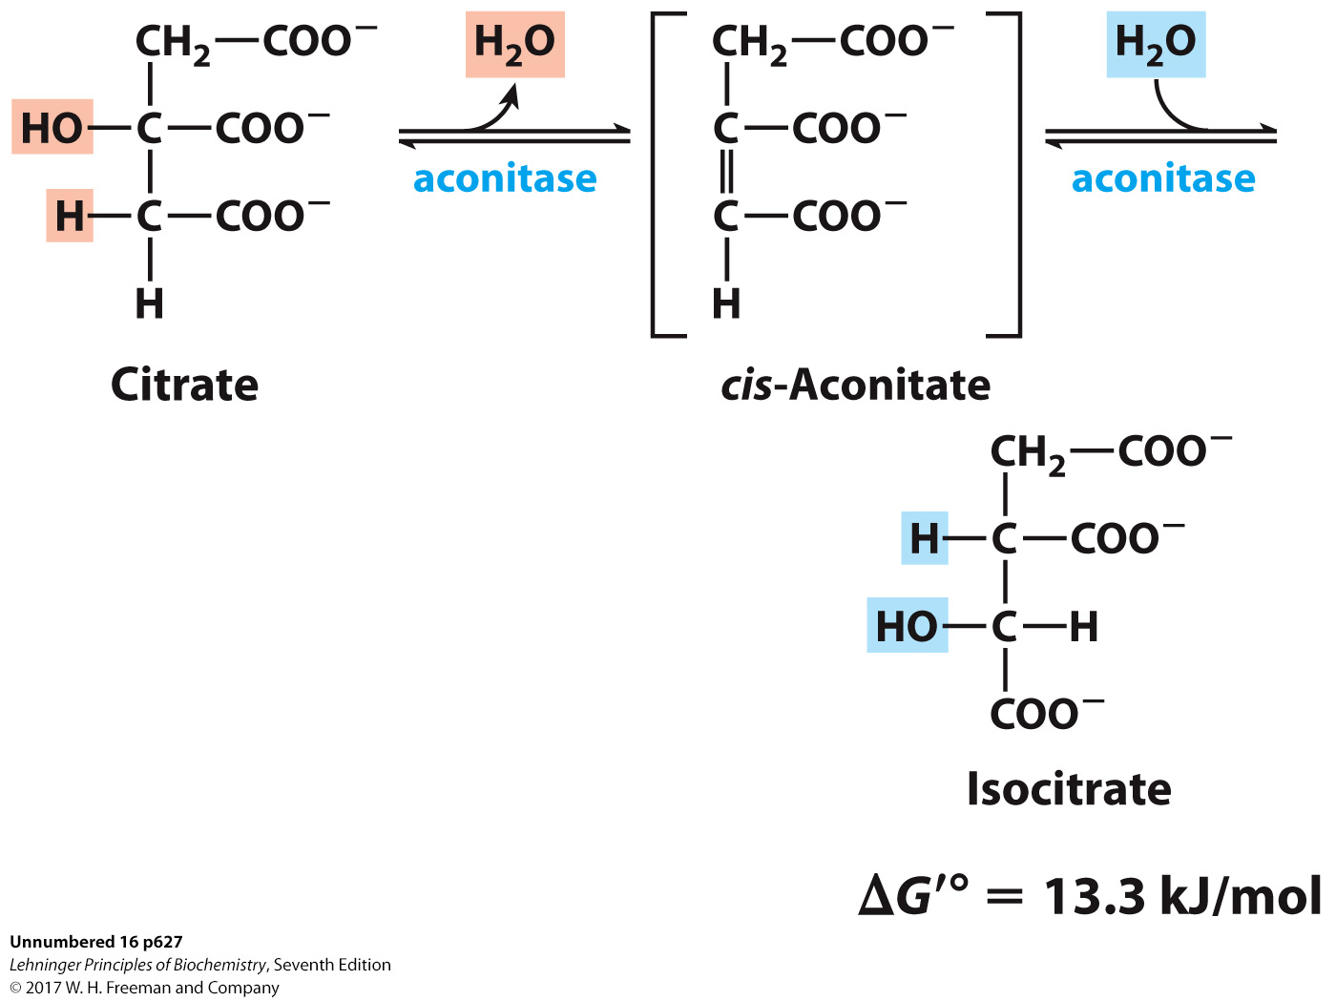
Isomerization by Dehydration/Rehydration
Elimination of H₂O from citrate gives a cis C=C bond.
Citrate, a tertiary alcohol, is a poor substrate for oxidation.
Isocitrate, a secondary alcohol, is a good substrate for oxidation.
Addition of H₂O to cis-aconitate is stereospecific.
Thermodynamically unfavorable/reversible
product concentration kept low to pull forward

Slide 23
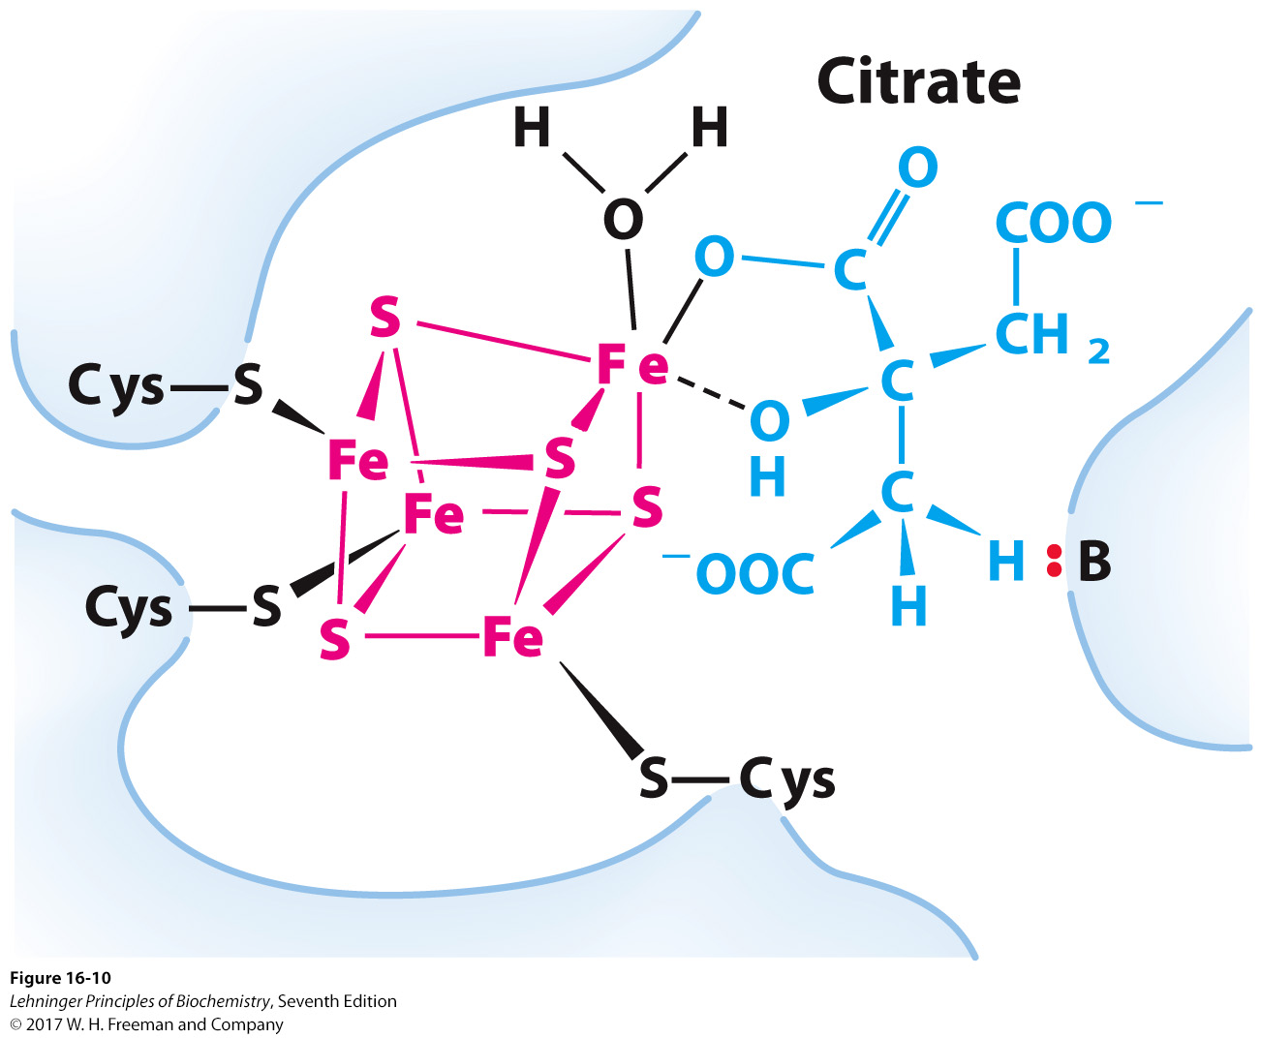
Iron-Sulfur Center in Aconitase
Water removal from citrate and subsequent addition to cis-aconitate are catalyzed by the iron-sulfur center: sensitive to oxidative stress.
Notes:
FIGURE 16–10 Iron-sulfur center in aconitase. The iron-sulfur center is in red, the citrate molecule in blue. Three Cys residues of the enzyme bind three iron atoms; the fourth iron is bound to one of the carboxyl groups of citrate and also interacts noncovalently with a hydroxyl group of citrate (dashed bond). A basic residue (:B) in the enzyme helps to position the citrate in the active site. The iron-sulfur center acts in both substrate binding and catalysis. The general properties of iron-sulfur proteins are discussed in Chapter 19 (see Fig. 19–5).

Slide 24
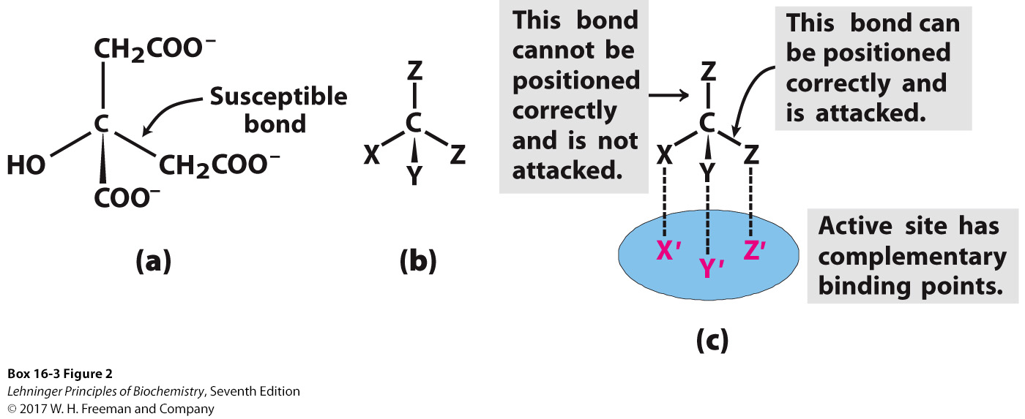
Aconitase Is Stereospecific
Only R-isocitrate is produced by aconitase.
Distinguished by three-point attachment to the active site
Notes:
BOX 6-3 FIGURE 2 The prochiral nature of citrate. (a) Structure of citrate; (b) schematic representation of citrate: X = -OH; Y = COO⁻; Z =
-CH₂COO⁻. (c) Correct complementary fit of citrate to the binding site of aconitase. There is only one way in which the three specified groups of citrate can fit on the three points of the binding site. Thus only one of the two -CH₂COO⁻ groups is bound by aconitase.

Slide 25
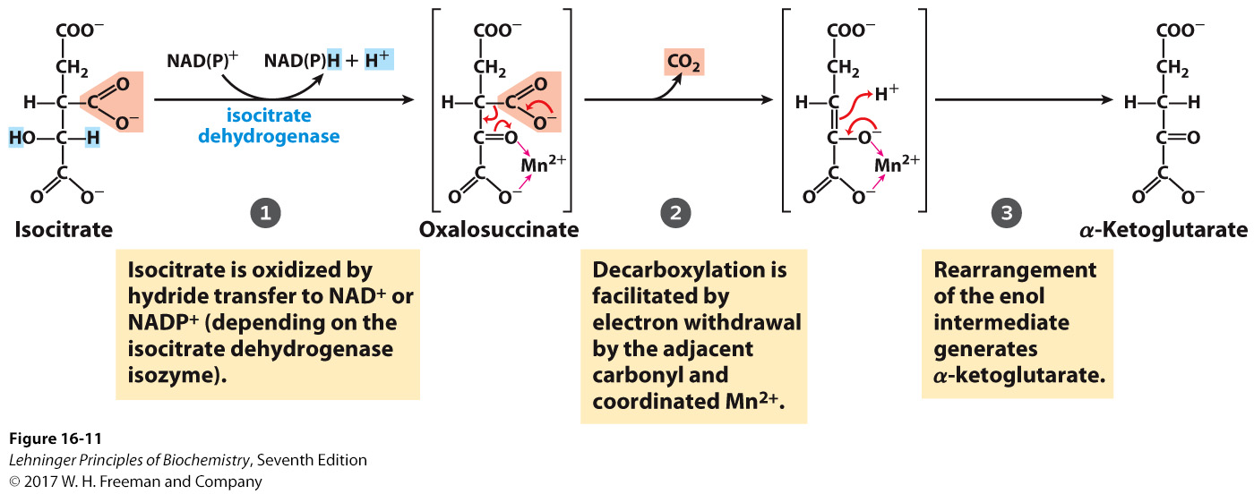
Oxidative Decarboxylation by Isocitrate Dehydrogenase
Isozymes are specific for NADP⁺ (cytosolic) or NAD⁺ (mitochondrial).
Decarboxylation releases CO₂.
Highly favorable/irreversible and regulated by [ATP]
Notes:
MECHANISM FIGURE 16–11 Isocitrate dehydrogenase. In this reaction, the substrate, isocitrate, loses one carbon by oxidative decarboxylation. See Figure 14–14 for more information on hydride transfer reactions involving NAD⁺ and NADP⁺.

Slide 26
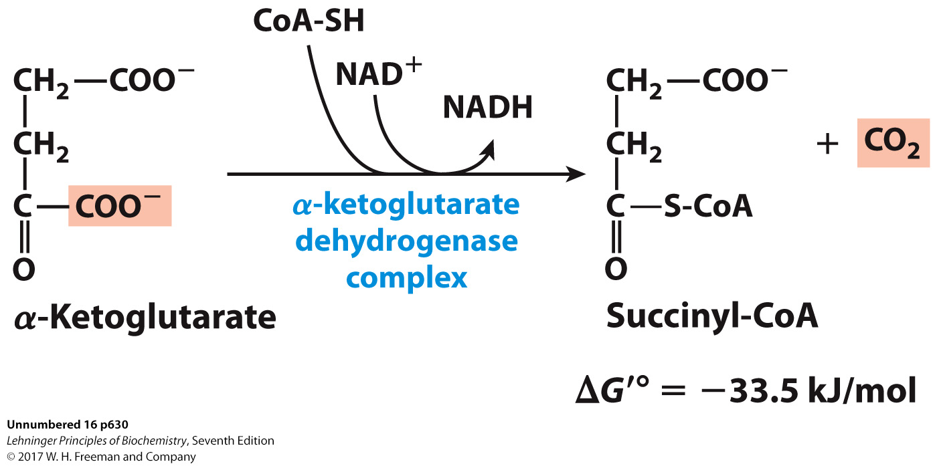
Final Oxidative Decarboxylation by α-Ketoglutarate Dehydrogenase

Slide 27
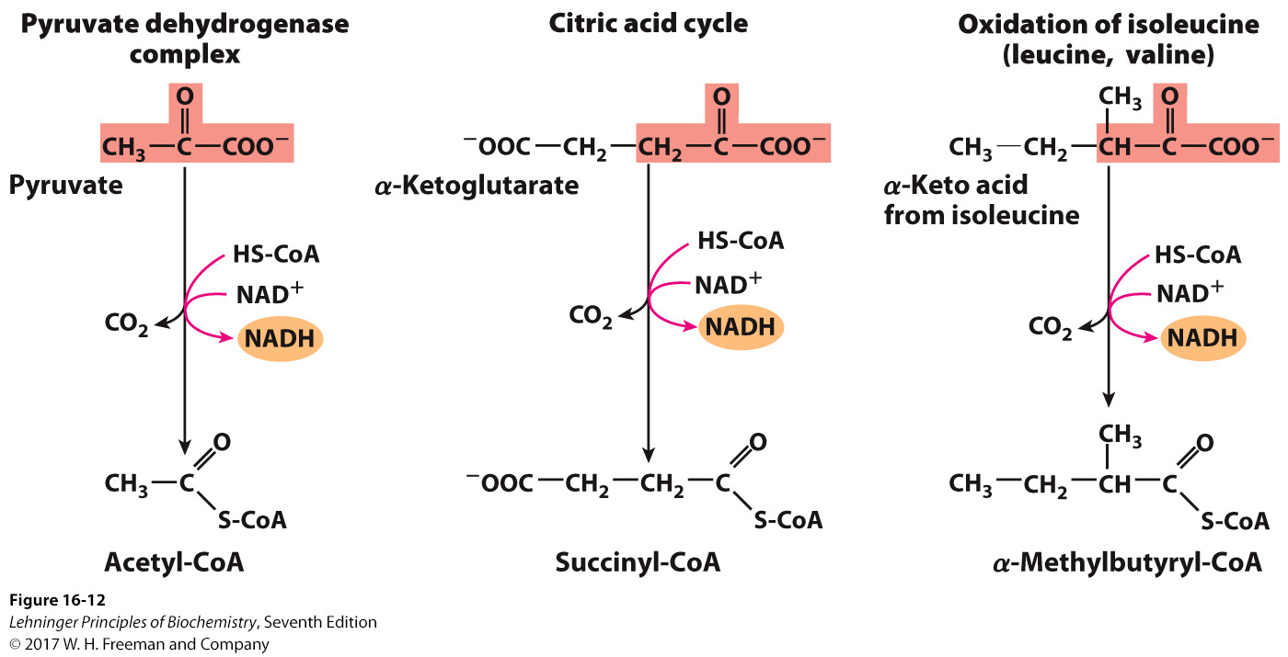
α-Ketoglutarate Dehydrogenase
Complex similar to pyruvate dehydrogenase
same coenzymes, identical mechanisms
active sites different to accommodate different-sized substrates
Notes:
FIGURE 16–12 A conserved mechanism for oxidative decarboxylation. The pathways shown employ the same five cofactors (thiamine pyrophosphate, coenzyme A, lipoate, FAD, and NAD⁺), closely similar multienzyme complexes, and the same enzymatic mechanism to carry out oxidative decarboxylations of pyruvate (by the pyruvate dehydrogenase complex), α-ketoglutarate (in the citric acid cycle), and the carbon skeletons of the three branched-chain amino acids, isoleucine (shown here), leucine, and valine. A fourth reaction, catalyzed by glycine decarboxylase, involves a very similar mechanism (see Fig. 20–22).

Slide 28
α-Ketoglutarate Dehydrogenase
Last oxidative decarboxylation
net full oxidation of all carbons of glucose
after two turns of the cycle
carbons not directly from glucose because carbons lost came from oxaloacetate, not acetate
Succinyl-CoA is another higher-energy thioester bond.
Highly thermodynamically favorable/irreversible
regulated by product inhibition

Slide 29
The Citric Acid Cycle (CAC)
Our City Is Kept Safe And Sound From Malice
Citrate Is Kreb’s Starting Substrate For Making Oxaloacetate
Can I Keep Selling Sex For Money, Officer?
Notes:
FIGURE 16–7 Reactions of the citric acid cycle. The carbon atoms shaded in pink are those derived from the acetate of acetyl-CoA in the first turn of the cycle; these are not the carbons released as CO₂ in the first turn. Note that in succinate and fumarate, the two-carbon group derived from acetate can no longer be specifically denoted; because succinate and fumarate are symmetric molecules, C-1 and C-2 are indistinguishable from C-4 and C-3. The number beside each reaction step corresponds to a numbered heading on pages xxx–xxx). The red arrows show where energy is conserved by electron transfer to FAD or NAD⁺, forming FADH₂ or NADH + H⁺. Steps 1, 3, and 4 are essentially irreversible in the cell; all other steps are reversible. The nucleoside triphosphate product of step 5 may be either ATP or GTP, depending on which succinyl-CoA synthetase isozyme is the catalyst.

Slide 30
Final Oxidative Decarboxylation by α-Ketoglutarate Dehydrogenase

Slide 31
α-Ketoglutarate Dehydrogenase
Complex similar to pyruvate dehydrogenase
same coenzymes, identical mechanisms
active sites different to accommodate different-sized substrates
Notes:
FIGURE 16–12 A conserved mechanism for oxidative decarboxylation. The pathways shown employ the same five cofactors (thiamine pyrophosphate, coenzyme A, lipoate, FAD, and NAD⁺), closely similar multienzyme complexes, and the same enzymatic mechanism to carry out oxidative decarboxylations of pyruvate (by the pyruvate dehydrogenase complex), α-ketoglutarate (in the citric acid cycle), and the carbon skeletons of the three branched-chain amino acids, isoleucine (shown here), leucine, and valine. A fourth reaction, catalyzed by glycine decarboxylase, involves a very similar mechanism (see Fig. 20–22).

Slide 32
α-Ketoglutarate Dehydrogenase
Last oxidative decarboxylation
net full oxidation of all carbons of glucose
after two turns of the cycle
carbons not directly from glucose because carbons lost came from oxaloacetate, not acetate
Succinyl-CoA is another higher-energy thioester bond.
Highly thermodynamically favorable/irreversible
regulated by product inhibition

Slide 33
Origin of C-Atoms in CO₂
Carbons from acetate are red.
All CO₂ generated during the citric acid cycle is produced before succinyl-CoA is made.
In one turn of the citric acid cycle, neither of the red carbons is lost.
Both CO₂ molecules lost were present on the oxaloacetate used to begin the cycle.
Notes:
We have lost 2 CO2 already, so we have a net complete oxidation of glucose after two pyruvates go through the TCA cycle.
But its not the actual carbons from pyruvate in each cycle.

Slide 34
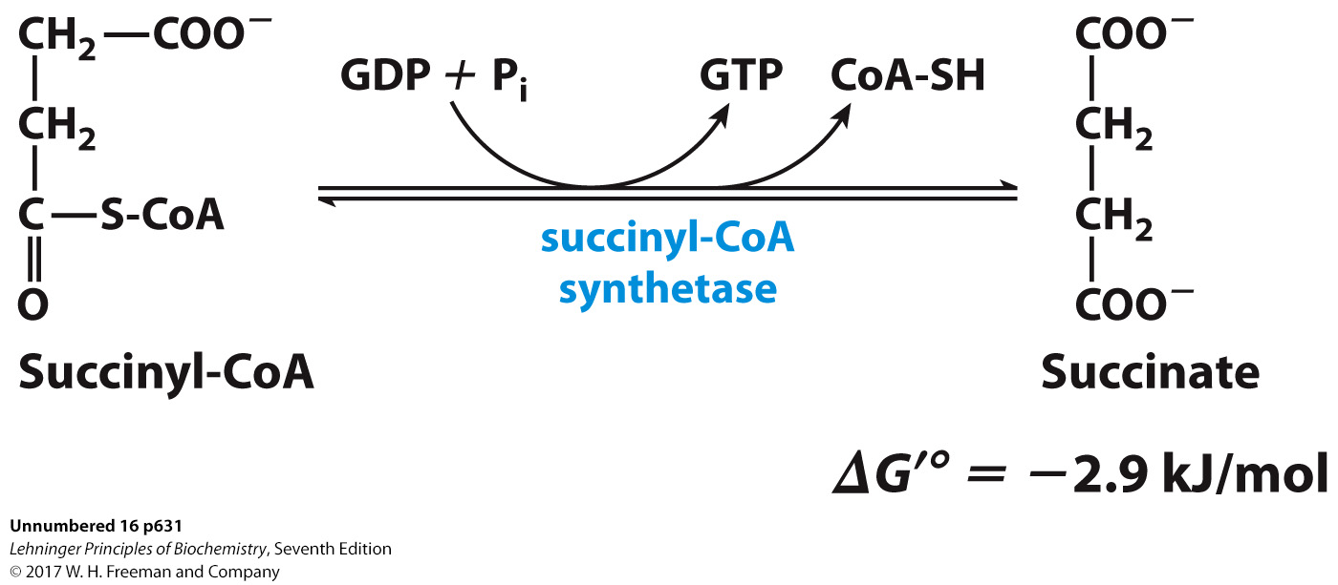
Generation of GTP Through Thioester: Substrate-Level Phosphorylation by Succinyl-CoA Synthetase

Slide 35
Succinyl-CoA Synthetase
Substrate-level phosphorylation
The energy of thioester allows for incorporation of inorganic phosphate.
Goes through a phospho-enzyme intermediate
Produces GTP, which can be converted to ATP
Slightly thermodynamically favorable/reversible
product concentration kept low to pull forward

Slide 36
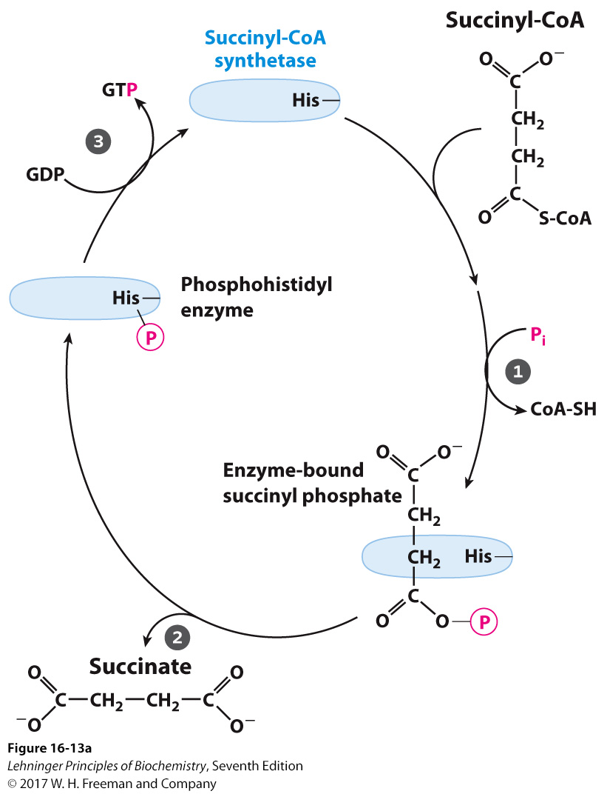
Mechanism of Succinyl-CoA Synthetase
Notes:
FIGURE 16–13a The succinyl-CoA synthetase reaction. (a) In step 1 a phosphoryl group replaces the CoA of succinyl-CoA bound to the enzyme, forming a high-energy acyl phosphate. In step 2 the succinyl phosphate donates its phosphoryl group to a His residue of the enzyme, forming a high-energy phosphohistidyl enzyme. In step 3 the phosphoryl group is transferred from the His residue to the terminal phosphate of GDP (or ADP), forming GTP (or ATP).

Slide 37
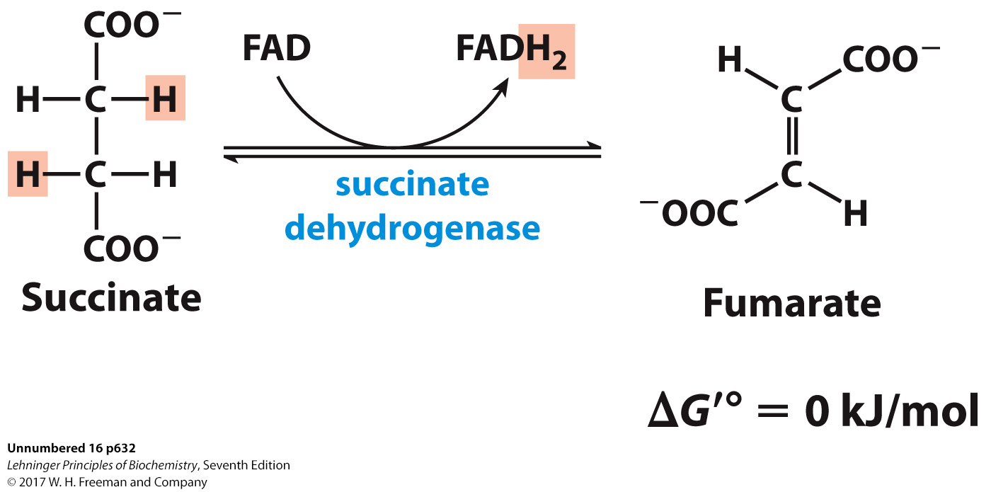
Oxidation of an Alkane to Alkene by Succinate Dehydrogenase
Bound to mitochondrial inner membrane
acts as Complex II in the electron-transport chain
FAD is covalently bound, unusual
Near equilibrium/reversible
product concentration kept low to pull forward

Slide 38
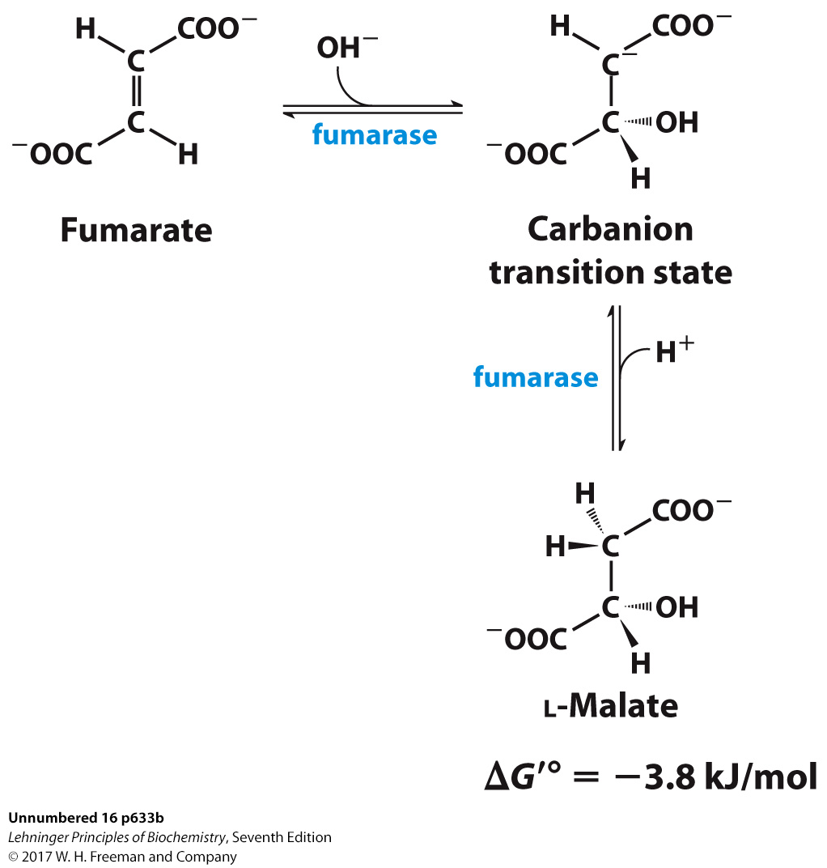
Hydration Across a Double Bond: Fumarase
Stereospecific
Addition of water is always trans and forms l-malate.
OH⁻ adds to fumarate… then H⁺ adds to the carbanion.
Cannot distinguish between inner carbons, so either can gain –OH
Slightly thermodynamically favorable/reversible
product concentration kept low to pull reaction forward

Slide 39
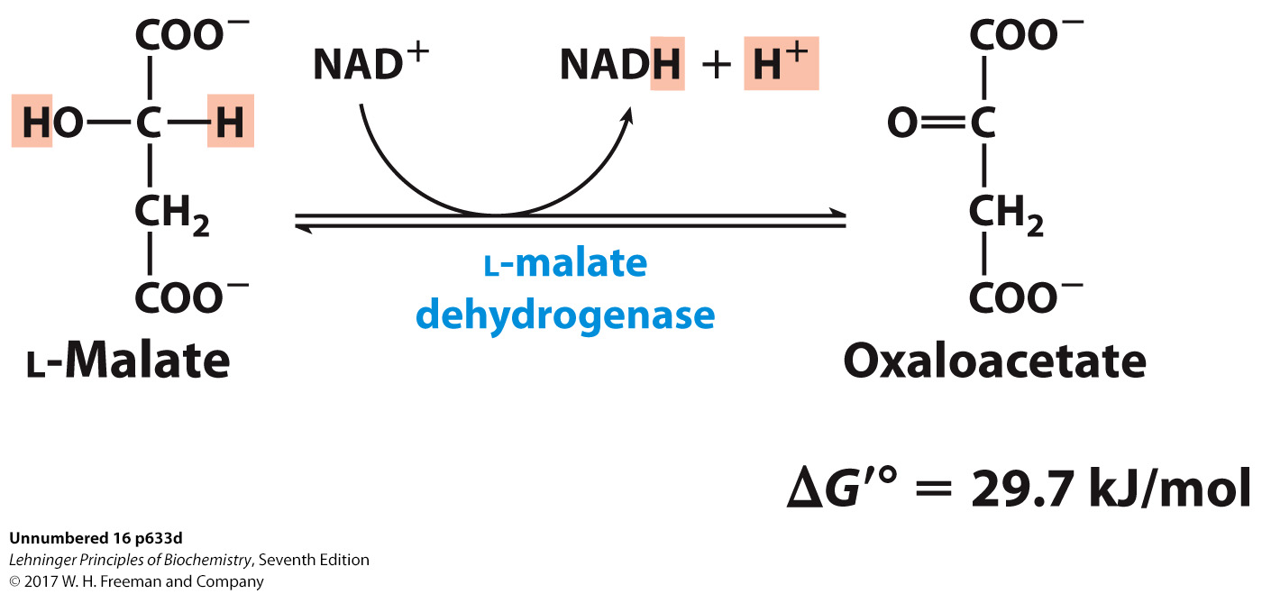
Oxidation of Alcohol to a Ketone and Regeneration of Oxaloacetate by Malate Dehydrogenase
Final step of the cycle
Regenerates oxaloacetate for citrate synthase
Highly thermodynamically UNfavorable/reversible
oxaloacetate concentration kept VERY low by citrate synthase
pulls the reaction forward

Slide 40
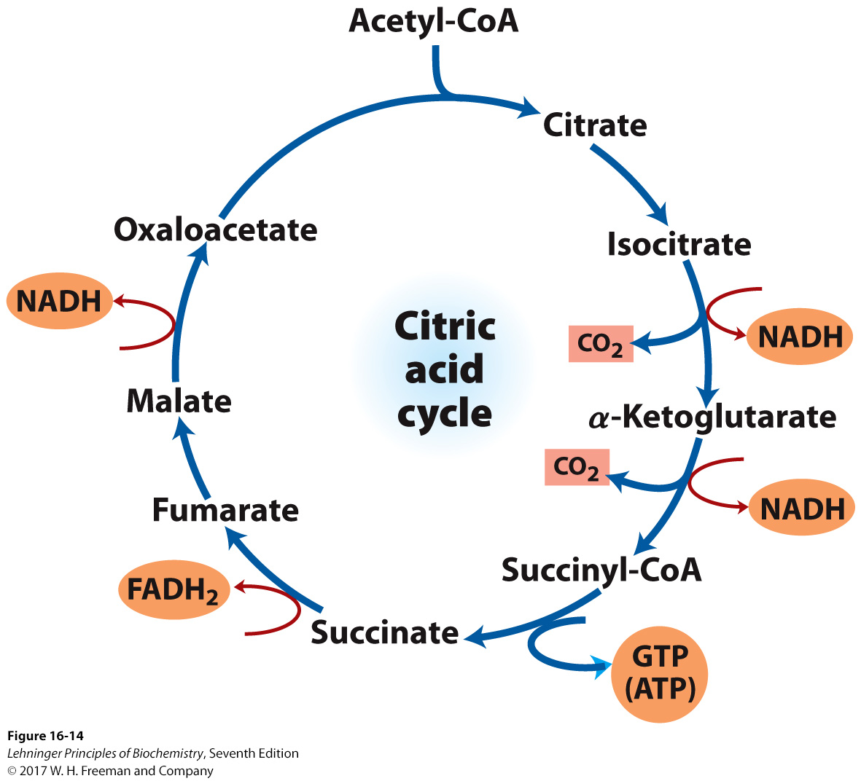
One Turn of the Citric Acid Cycle
Notes:
FIGURE 16–14 Products of one turn of the citric acid cycle. At each turn of the cycle, three NADH, one FADH₂, one GTP (or ATP), and two CO₂ are released in oxidative decarboxylation reactions. Here and in several following figures, all cycle reactions are shown as proceeding in one direction only, but keep in mind that most of the reactions are reversible (see Fig. 16–7).

Slide 41
Net Result of the Citric Acid Cycle
Acetyl-CoA + 3NAD⁺ + FAD + GDP + P_{i} + 2 H₂O →
2CO₂ + 3NADH + FADH₂ + GTP + CoA + 3H⁺
Net oxidation of two carbons to CO₂
equivalent to two carbons of acetyl-CoA
but NOT the exact same carbons
Energy captured by electron transfer to NADH and FADH₂
Generates 1 GTP, which can be converted to ATP
Completion of cycle

Slide 42
Direct and Indirect ATP Yield
TABLE 16-1 | Stoichiometry of Coenzyme Reduction and ATP Formation in the Aerobic Oxidation of Glucose via Glycolysis, the Pyruvate Dehydrogenase Complex Reaction, the Citric Acid Cycle, and Oxidative Phosphorylation
Reaction |  | Number of ATP or reduced coenzyme directly formed | Number of ATP ultimately formedª
Glucose → glucose 6-phosphate |  | –1 ATP | –1
Fructose 6-phosphate → fructose 1,6-bisphosphate |  | –1 ATP | –1
2 Glyceraldehyde 3-phosphate → 2 1,3-bisphosphoglycerate |  | 2 NADH | 3 or 5^{b}
2 1,3-Bisphosphoglycerate → 2 3-phosphoglycerate |  | 2 ATP | 2
2 Phosphoenolpyruvate → 2 pyruvate |  | 2 ATP | 2
2 Pyruvate → 2 acetyl-CoA |  | 2 NADH | 5
2 Isocitrate → 2 α-ketoglutarate |  | 2 NADH | 5
2 α-Ketoglutarate → 2 succinyl-CoA |  | 2 NADH | 5
2 Succinyl-CoA → 2 succinate |  | 2 ATP (or 2 GTP) | 2
2 Succinate → 2 fumarate |  | 2 FADH₂ | 3
2 Malate → 2 oxaloacetate |  | 2 NADH | 5
Total |  |  | 30-32
ªThis is calculated as 2.5 ATP per NADH and 1.5 ATP per FADH₂. A negative value indicates consumption. ^{b}This number is either 3 or 5, depending on the mechanism used to shuttle NADH equivalents from the cytosol to the mitochondrial matrix; see Figures 19-30 and 19-31.

Slide 43
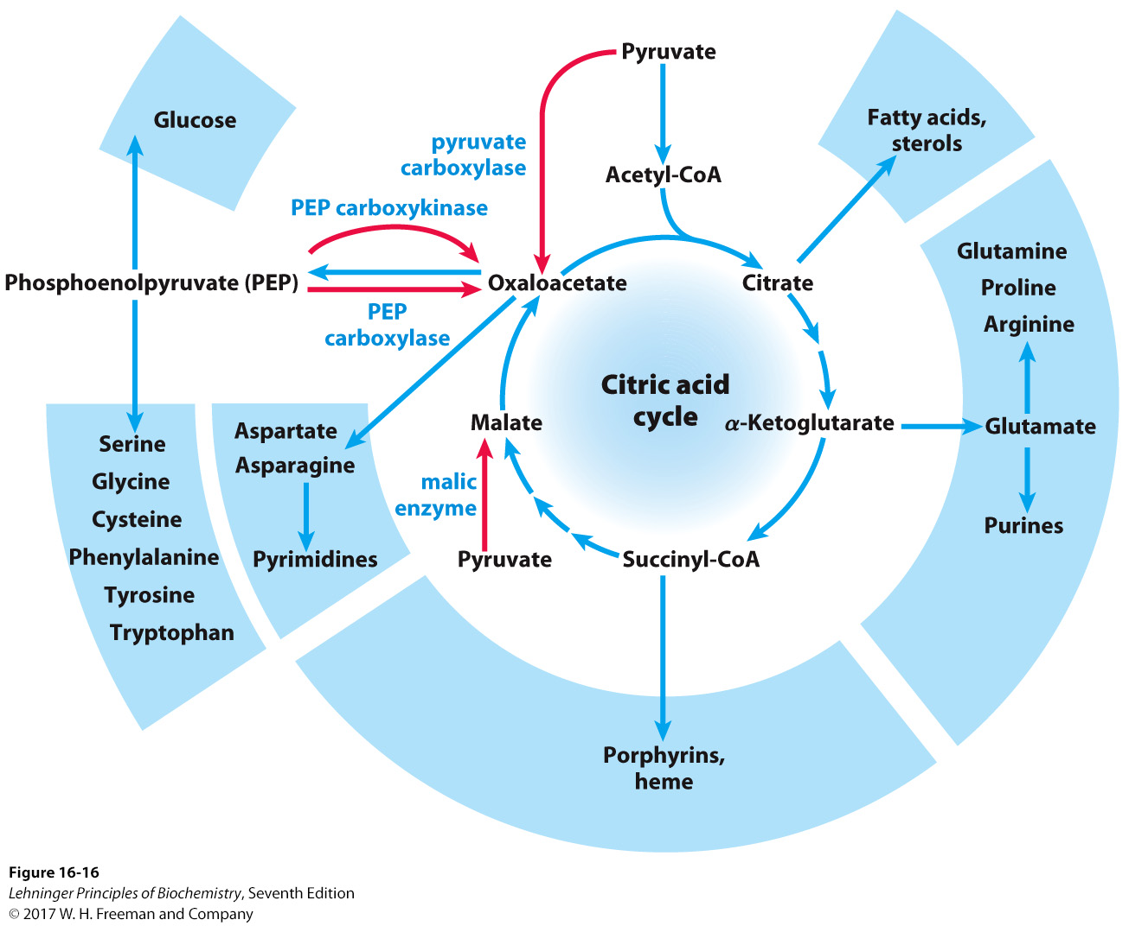
CAC Intermediates Are Amphibolic
Notes:
FIGURE 16–16 Role of the citric acid cycle in anabolism. Intermediates of the citric acid cycle are drawn off as precursors in many biosynthetic pathways. Shown in red are four anaplerotic reactions that replenish depleted cycle intermediates (see Table 16–2).

Slide 44
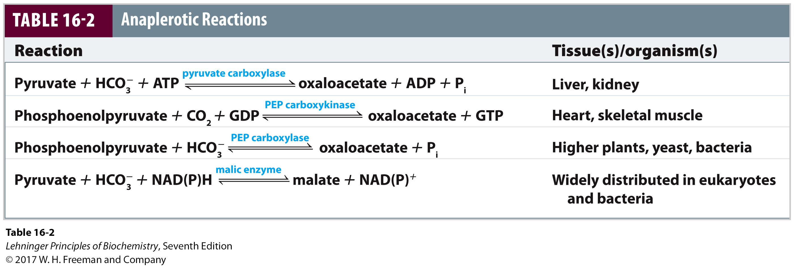
Anaplerotic Reactions
Intermediates in the citric acid cycle can be used in biosynthetic pathways (removed from cycle).
Must replenish the intermediates in order for the cycle and central metabolic pathway to continue
4-carbon intermediates are formed by carboxylation of 3-carbon precursors.

Slide 45
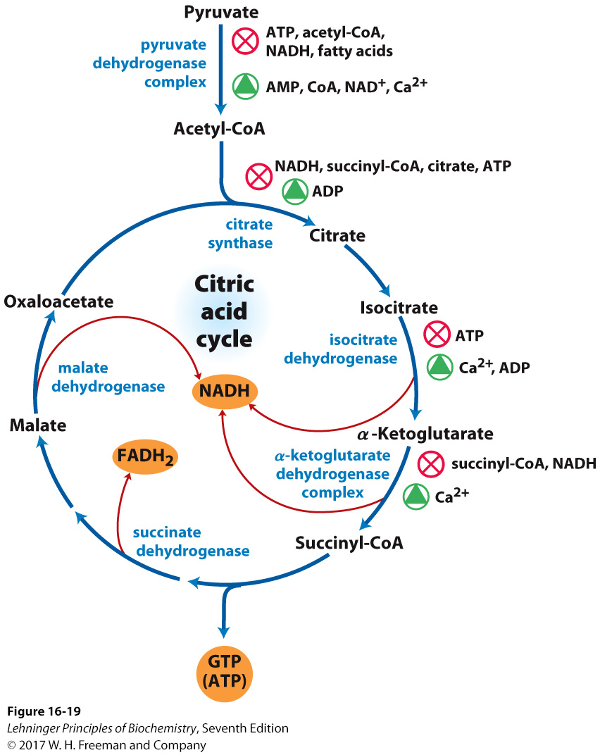
Regulation of the Citric Acid Cycle
Notes:
FIGURE 16–19 Regulation of metabolite flow from the PDH complex through the citric acid cycle in mammals. The PDH complex is allosterically inhibited when [ATP]/[ADP], [NADH]/[NAD⁺], and [acetyl-CoA]/[CoA] ratios are high, indicating an energy-sufficient metabolic state. When these ratios decrease, allosteric activation of pyruvate oxidation results. The rate of flow through the citric acid cycle can be limited by the availability of the citrate synthase substrates, oxaloacetate and acetyl-CoA, or of NAD⁺, which is depleted by its conversion to NADH, slowing the three NAD-dependent oxidation steps. Feedback inhibition by succinyl-CoA, citrate, and ATP also slows the cycle by inhibiting early steps. In muscle tissue, Ca²⁺ signals contraction and, as shown here, stimulates energy-yielding metabolism to replace the ATP consumed by contraction.

Slide 46
Regulation of the Citric Acid Cycle
Regulated at highly thermodynamically favorable and irreversible steps
PDH, citrate synthase, IDH, and KDH
General regulatory mechanism
activated by substrate availability
inhibited by product accumulation
Overall products of the pathway are NADH and ATP.
affect all regulated enzymes in the cycle
inhibitors: NADH and ATP
activators: NAD+ and AMP

Slide 47
Regulation of Pyruvate Dehydrogenase
Also regulated by reversible phosphorylation of E1
phosphorylation: inactive
dephosphorylation: active
PDH kinase and PDH phosphorylase are part of mammalian PDH complex.
Kinase is activated by ATP.
high ATP → phosphorylated PDH → less acetyl-CoA
low ATP → kinase is less active and phosphorylase removes phosphate from PDH → more acetyl-CoA
Regulation of PDH is somewhat similar to regulation of the glycogen synthase/glycogen phosphorylase complex.

Slide 48
Additional Regulatory Mechanisms
Citrate synthase is also inhibited by succinyl-CoA.
α-Ketoglutarate is an important branch point for amino acid metabolism.
Succinyl-CoA communicates flow at this branch point to the start of the cycle.
Regulation of isocitrate dehydrogenase controls citrate levels.
Aconitase is reversible.
Inhibition of IDH leads to accumulation of isocitrate and reverses acconitase.
Accumulated citrate leaves mitochondria and inhibits phosphofructokinase in glycolysis.

